Slide 1

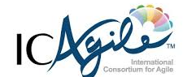
Chapter 2:
Kubernetes Installation and Architecture
Agile Brains Consulting
1
©Agile Brains Consulting Inc. All rights reserved. Not to be reproduced without prior written consent.

Slide 2
Table of Content
Kubernetes Architecture
Master node components and role
Worker node components and role
Installation of kubeadm in a single node cluster
Kubectl
Managing multiple Kubernetes cluster
Cloud Controller Manager

Slide 3
What is Kubernetes?
Kubernetes is inspired from an internal Google project called Borg
Open source container orchestration project managed by the Linux Foundation
Unified API for deploying web applications, batch jobs, and databases
Decouples applications from machines through containers
Declarative approach to deploying applications
Automates application configuration through service discovery
Maintains and tracks the global view of the cluster
APIs for deployment workflows
Rolling updates, Autoscaling
Agile Brains Consulting
3
©Agile Brains Consulting Inc. All rights reserved. Not to be reproduced without prior written consent.

Slide 4
Kubernetes Architecture (Bird’s eye view)
Yaml/Json
config file
Kubernetes Master
API
Node 1
Node 2
UI
Node 3
CLI
Node n
Registry
Agile Brains Consulting
4
©Agile Brains Consulting Inc. All rights reserved. Not to be reproduced without prior written consent.

Slide 5
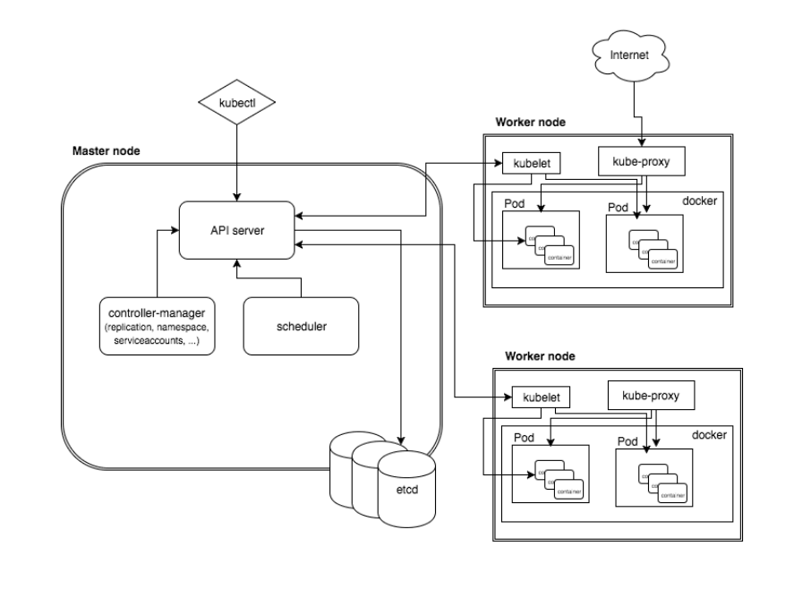
K8s Architecture – detailed
Agile Brains Consulting
5
©Agile Brains Consulting Inc. All rights reserved. Not to be reproduced without prior written consent.

Slide 6
Install Kubernetes on AWS using KubeAdm
Agile Brains Consulting
6
©Agile Brains Consulting Inc. All rights reserved. Not to be reproduced without prior written consent.

Slide 7
Lab: Single node cluster installation using KubeAdm
** Master node need to have at least 2 CPUs
https://github.com/shekhar2010us/kubernetes_teach_git/blob/master/kubernetes_single_node_cluster_installation.md
** Do this lab the first thing – so that we all have machines with Docker which will be used to run exercises in lab 1
** Instructions for installing multi-node k8s cluster is provided in the above link
Agile Brains Consulting
7
©Agile Brains Consulting Inc. All rights reserved. Not to be reproduced without prior written consent.

Slide 8
Kubectl
Agile Brains Consulting
8
©Agile Brains Consulting Inc. All rights reserved. Not to be reproduced without prior written consent.

Slide 9
Kubectl
kubectl is Kubernetes command-line tool for running commands against Kubernetes clusters.
It can be used to deploy and manage applications on Kubernetes.
Using kubectl, you can inspect cluster resources; create, delete, and update components; look at your new cluster; and bring up example apps etc.
Kubernetes Java client
https://github.com/kubernetes-client/java#installation
Agile Brains Consulting
9
©Agile Brains Consulting Inc. All rights reserved. Not to be reproduced without prior written consent.

Slide 10
Kubectl – Installation
https://kubernetes.io/docs/tasks/tools/install-kubectl/
On Ubuntu/Debian
sudo apt-get update && sudo apt-get install -y apt-transport-https
curl -s https://packages.cloud.google.com/apt/doc/apt-key.gpg | sudo apt-key add -
echo "deb https://apt.kubernetes.io/ kubernetes-xenial main" | sudo tee -a /etc/apt/sources.list.d/kubernetes.list
sudo apt-get update
sudo apt-get install -y kubectl
To check installation (execute):
kubectl version
** Note: We have already done it while K8s installation
Agile Brains Consulting
10
©Agile Brains Consulting Inc. All rights reserved. Not to be reproduced without prior written consent.

Slide 11
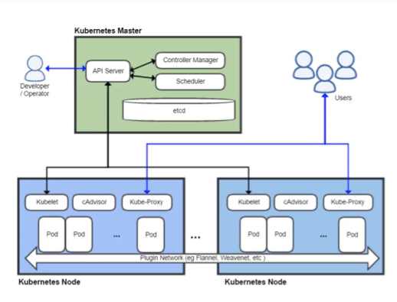
Nodes: Master and Worker
Agile Brains Consulting
11
©Agile Brains Consulting Inc. All rights reserved. Not to be reproduced without prior written consent.

Slide 12
Kubernetes: Any Node
Any kubernetes node contains:
Addresses
Hostname
External IP
Internal IP
Condition - describe condition of nodes – OutOfDisk, Ready, MemoryPressure, DiskPressure, NetworkUnavailable
Capacity - describe the resources available on the nods – CPU, memory, maximum number of pods that can be scheduled onto the node
Info – general information about the node – kernel version, Kubernetes version, kubelet and kube-proxy version, Docker version, OS name
Command to get node details:
kubectl describe nodes <node_name>
Agile Brains Consulting
12
©Agile Brains Consulting Inc. All rights reserved. Not to be reproduced without prior written consent.

Slide 13
Master Node
Agile Brains Consulting
13
©Agile Brains Consulting Inc. All rights reserved. Not to be reproduced without prior written consent.

Slide 14
Master Node Role
Master components make global decisions about the cluster (for example, scheduling), and detecting and responding to cluster events (starting up a new pod when a replication controller’s ‘replicas’ field is unsatisfied).
Master components can be run on any machine in the cluster. However, for simplicity, set up scripts typically start all master components on the same machine, and do not run user containers on this machine.
Agile Brains Consulting
14
©Agile Brains Consulting Inc. All rights reserved. Not to be reproduced without prior written consent.

Slide 15
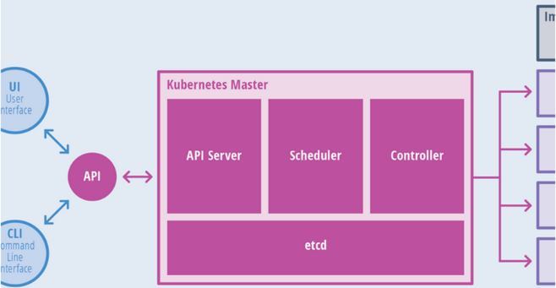
Master Node Components
Components of master:
API Server
Scheduler
Controller
etcd
Agile Brains Consulting
15
©Agile Brains Consulting Inc. All rights reserved. Not to be reproduced without prior written consent.

Slide 16
Master Node Components
The API server is the entry points for all the REST commands used to control the cluster. It processes REST requests, validates them, and executes the bound business logic. The result state has to be persisted in the “etcd” component.
Etcd is an open source, distributed key-value database; it acts as a single source of truth (SSOT) for all components of the Kubernetes cluster. Masters query etcd to retrieve various parameters of the state of the nodes, pods and containers. Etcd is considered a metadata service in Kubernetes.
Agile Brains Consulting
16
©Agile Brains Consulting Inc. All rights reserved. Not to be reproduced without prior written consent.

Slide 17
Master Node Components
Controller Manager is responsible for most of the collectors that regulate the state of the cluster. In general, a controller can be considered a daemon that runs in nonterminating loop and is responsible for collecting and sending information to the API server. It works toward getting the shared state of cluster and then making changes to bring the current status of the server to the desired state. The key controllers are replication controller, namespace controller, and service account controller. The controller manager runs different kind of controllers to handle nodes, endpoints, etc.
Scheduler is one of the key components of Kubernetes master. It is responsible for distributing the workload, tracking resource utilization on cluster nodes and selecting the nodes for the workloads to run. In other words, this is the mechanism responsible for allocating pods to available nodes.
Agile Brains Consulting
17
©Agile Brains Consulting Inc. All rights reserved. Not to be reproduced without prior written consent.

Slide 18
Worker Node
Agile Brains Consulting
18
©Agile Brains Consulting Inc. All rights reserved. Not to be reproduced without prior written consent.

Slide 19
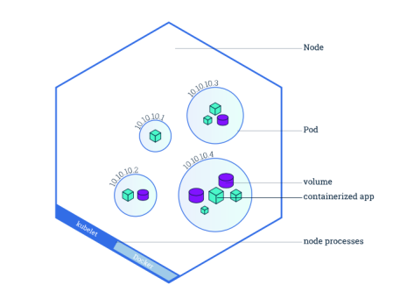
Worker Node Roles
A node is a worker machine in Kubernetes. A node may be a VM or physical machine, depending on the cluster. Each node has the services necessary to run pods and is managed by the master components. The services on a node include Docker, kubelet and kube-proxy.
Allows Pods to be scheduled. A basic worker physical or virtual machine of Kubernetes.
Must be managed by a master
May host multiple pods
Internal IP Address endpoint
Can be tagged and filtered using labels
Agile Brains Consulting
19
©Agile Brains Consulting Inc. All rights reserved. Not to be reproduced without prior written consent.

Slide 20
Worker Node Components
kubelet Service interacts with etcd store to read configuration details and to write values via api-server. It communicates with the master component to receive commands and work. The kubelet process then assumes responsibility for maintaining the state of work and the node server. It manages network rules, port forwarding, etc.
kubelet takes a set of PodSpecs that are provided through various mechanisms and ensures that the containers described in those PodSpecs are running and healthy. The kubelet doesn’t manage containers which were not created by Kubernetes.
Agile Brains Consulting
20
©Agile Brains Consulting Inc. All rights reserved. Not to be reproduced without prior written consent.

Slide 21
Worker Node Components
kube-proxy enables the Kubernetes service abstraction by maintaining network rules on the host and performing connection forwarding.
Kubernetes Proxy Service is a proxy service which runs on each node and helps in making services available to the external host. It helps in forwarding the request to correct containers and is capable of performing primitive load balancing. It makes sure that the networking environment is predictable and accessible and at the same time it is isolated as well. It manages pods on node, volumes, secrets, creating new containers’ health checkup, etc.
Agile Brains Consulting
21
©Agile Brains Consulting Inc. All rights reserved. Not to be reproduced without prior written consent.

Slide 22
Cloud Controller Manager
Agile Brains Consulting
22
©Agile Brains Consulting Inc. All rights reserved. Not to be reproduced without prior written consent.

Slide 23
Cloud Controller Manager (CCM)
Initially part of kube-controller-manager
CCM was created to allow cloud vendor code and k8s core to evolve independent of one another
Runs along other master components
Can also be started as a Kubernetes add-on, in which case it runs on top of Kubernetes
Design is based on a plugin mechanism
Agile Brains Consulting
23
©Agile Brains Consulting Inc. All rights reserved. Not to be reproduced without prior written consent.
Notes:
https://kubernetes.io/docs/concepts/architecture/cloud-controller/

Slide 24
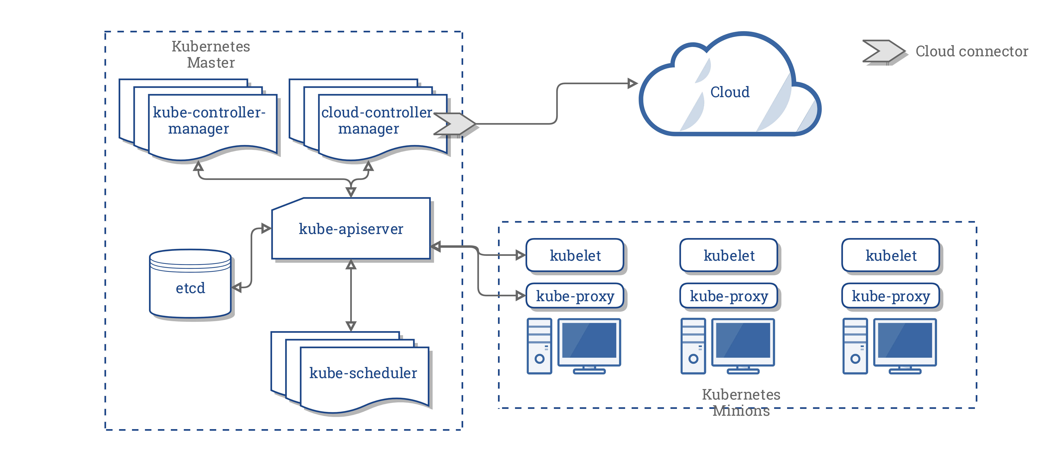
Cloud Controller Manager (CCM)
Agile Brains Consulting
24
©Agile Brains Consulting Inc. All rights reserved. Not to be reproduced without prior written consent.
Notes:
https://kubernetes.io/docs/concepts/architecture/cloud-controller/

Slide 25
Running Cloud Controllers
Infrastructure requirements
cloud authentication/authorization
kubernetes authentication/authorization
high availability
Configuration changes
kube-apiserver and kube-controller-manager MUST NOT specify the --cloud-provider flag
kubelet must run with --cloud-provider=external
** Either change the config while Master node setup OR change here - /etc/kubernetes/manifests/kube-apiserver.yaml
Agile Brains Consulting
25
©Agile Brains Consulting Inc. All rights reserved. Not to be reproduced without prior written consent.

Slide 26
Example Cloud Controllers
Cloud vendors
Digital Ocean, OCI, Rancher
Examples of CCM
Node Controller: For checking the cloud provider to determine if a node has been deleted in the cloud after it stops responding
Route Controller: For setting up routes in the underlying cloud infrastructure
Service Controller: For creating, updating and deleting cloud provider load balancers
PersistentVolumeLabels controller: It applies labels on AWS EBS/GCE PD volumes when they are created. This removes the need for users to manually set the labels on these volumes.
Agile Brains Consulting
26
©Agile Brains Consulting Inc. All rights reserved. Not to be reproduced without prior written consent.

